Slide 1
Sign in logic
Back end Logic

Slide 2
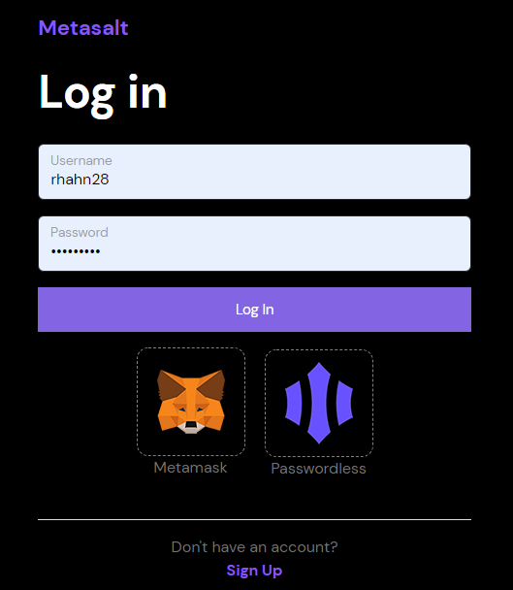


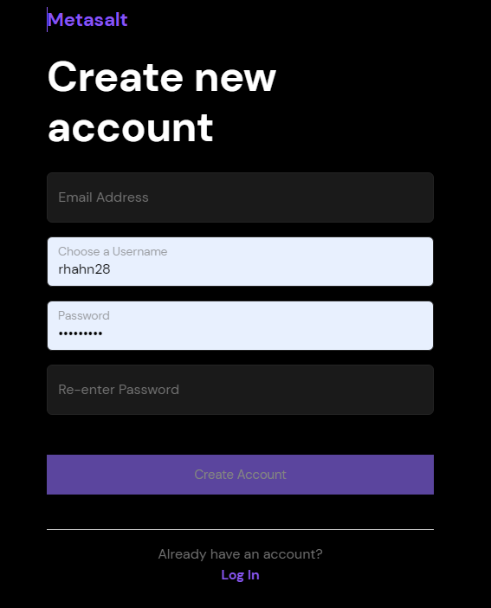
Email Login
Sigingin
+CREATE NFT
+BUY METASALT
Check backend if
Wallet exists. If not, user creates new wallet. If yes, user logs out and back in w/existing wallet
Popup,
You need to sign into Metamask to do these tasks
START
+CREATE NFT GATE
No Popup
Email Login
+BUY/SELL NFTs
No Popup until user wants to buy NFT
Check. If no account, then say, no such accounts exists. redirect to signup page
Do you want enter gate or buy NFT?
No Popup until reveal of NFT to enter gate
Metamask Login
Check backend if
Email exists. Ask if they want, so they receive notifications.
Same as email login above.
Check backend if
Wallet exists. If not, user creates new wallet. If yes, user logs out and back in w/existing wallet
Check. If user already exists, then say, login or create new profile
Magic link Login

Slide 3
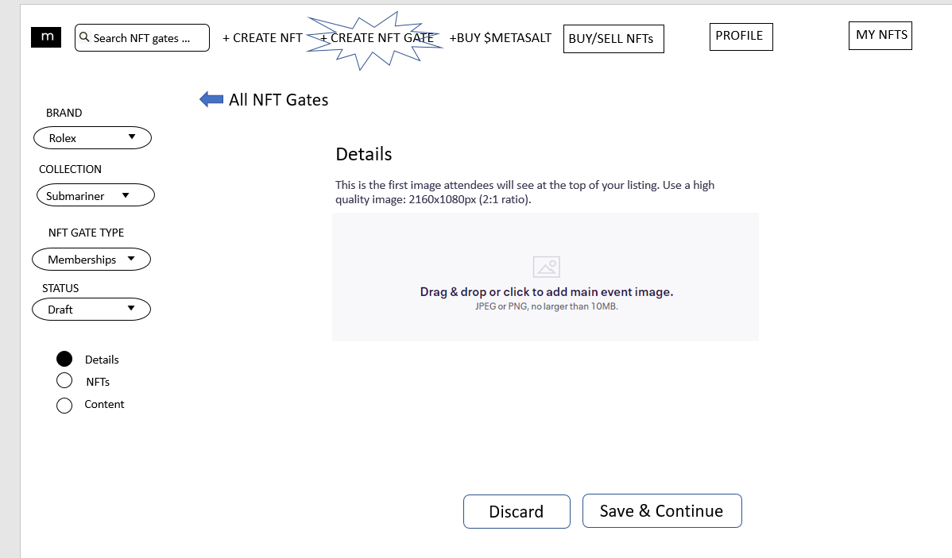
Sigingin
+BUY METASALT
Check backend if
Wallet exists. If not, user creates new wallet. If yes, user logs out and back in w/existing wallet
Popup,
You need to sign into Metamask to do these tasks
START
+CREATE NFT GATE
No Popup
Email Login
Check. If no account, then say, no such accounts exists. redirect to signup page
+BUY/SELL NFTs
No Popup until user wants to buy NFT
Do you want enter gate or buy NFT?
Check. If user already exists, then say, login or create new profile
No Popup until reveal of NFT to enter gate

